Slide 1
Git, github, and Docker
Developing Portable, Tracible, Reproducible Bioinformatic Pipelines

Slide 2
AGENDA Day 2
Python Type-hinting
Set Up A Central Repo For Our Work
Review Specs For Our RPS Project
Design Our Project And Split Into Teams
Start Our Project Container
Create Project Packages And Functions As Teams
Review Results And Set Version 1.0
Plan Version 2.0 Specs

Slide 3
AGENDA Day 3
How The Internet Works… Sort Of
Review Specs For Our RPSLS Project
Design Our Project And Split Into Teams
Make Updates To Our Requirements And Container
Create Project Packages And Functions As Teams
Review Results And Set Version 2.0
Talk About Other Potential Extensions

Slide 4
Introduction
Docker is an extremely flexible, versatile system for running containers that allows for virtual networking between them, complex orchestration and scaling, and even higher orders of automation through systems like Kubernetes. That said, most use cases in bioinformatics follow a much simpler pattern.
Also, now that you have an IDE up and running, let’s start using type-hinting so it can catch errors before we have to debug them.

Slide 5
Folder mounting in docker
The most common way of moving your data in and out of folders for bioinformatics

Slide 6
Remember this command
docker container run -it --rm -v c:\Users\username\fastqs:/data biocontainers/bwa:latest /bin/bash

Slide 7
Remember this command
docker container run -it --rm -v c:\Users\username\fastqs:/data biocontainers/bwa:latest /bin/bash
General start for a command to run a docker container

Slide 8
Remember this command
docker container run -it --rm -v c:\Users\username\fastqs:/data biocontainers/bwa:latest /bin/bash
-it Combination of -i and -t arguments
-i Keep STDIN open
-t Keep a TTY connected
Result: Connects your interactive shell to your container
--rm Delete the container upon its termination

Slide 9
Remember this command
docker container run -it --rm -v c:\Users\username\fastqs:/data biocontainers/bwa:latest /bin/bash
-v hostpath:containerpath
Tells the container to mount (in this case) the host folder
c:\Users\username\fastqs into the container at the location
/data
If your settings are correct, you should be able to read and
write to this folder and it will show up in the host system.
This is the most common way I’ve seen in bioinformatic
pipelines to move data in and out of a container

Slide 10
Remember this command
docker container run -it --rm -v c:\Users\username\fastqs:/data biocontainers/bwa:latest /bin/bash
Specifies the container image to use for this run.
In this case, we are specifying the BWA aligner container
from the biocontainers group (a common source for
bioinformatics docker containers), latest version.
For running in a fixed pipeline, avoid using “latest” and
instead try to specify a fixed version number (because “latest”
will always change with new versions being released.

Slide 11
Remember this command
docker container run -it --rm -v c:\Users\username\fastqs:/data biocontainers/bwa:latest /bin/bash
The command to run inside the container
In this case, after running this command, you will be inside of the latest version of the BWA container from Biocontainers with an interactive shell to run commands. Your fastq folder will be found at /data inside the container. You can also have multiple -v arguments to mount multiple host folders in multiple places if you need to also mount in a folder of reference genomes.

Slide 12
VCS Branching
What kind of branching scheme is right for you?

Slide 13
Important questions to ask
How critical is the system involved?
If a new change turns out to break things:
Will I be slightly inconvenienced?
Will my lab’s bioinformatic pipeline go down and leave people unproductive for days?
Will actual patients face potential misdiagnosis?
How many people will work on and use this project?
Is this a small project me and a few others in my lab?
Will it be used throughout my field?
Will it become a standard bioinformatic tool supporting a major field of research?
How will this be used and distributed?
Will this be running as a web service where people connect to the production server and never run the code themselves?
Will most users be downloading the repo and running locally?

Slide 14
Common Branching Schemes
0.1.0
0.1.1
1.0.0
2.0.0
Linear (probably unwise)

Slide 15
Common Branching Schemes
0.1.0
0.1.1
1.0.0
2.0.0
LOL NO!
Experimentation and Feature Addition

Slide 16
Common Branching Schemes
0.1.0
0.1.1
1.0.0
2.0.0
1.0.1
Experimentation and Feature Addition
+ a bug fix

Slide 17
Common Branching Schemes
Project
Project
Project
Development
Testing
Staging
Production
Stable Development
Often paired with continuous integration and delivery

Slide 18
Type Hinting
Making Python a little more self-documenting

Slide 19
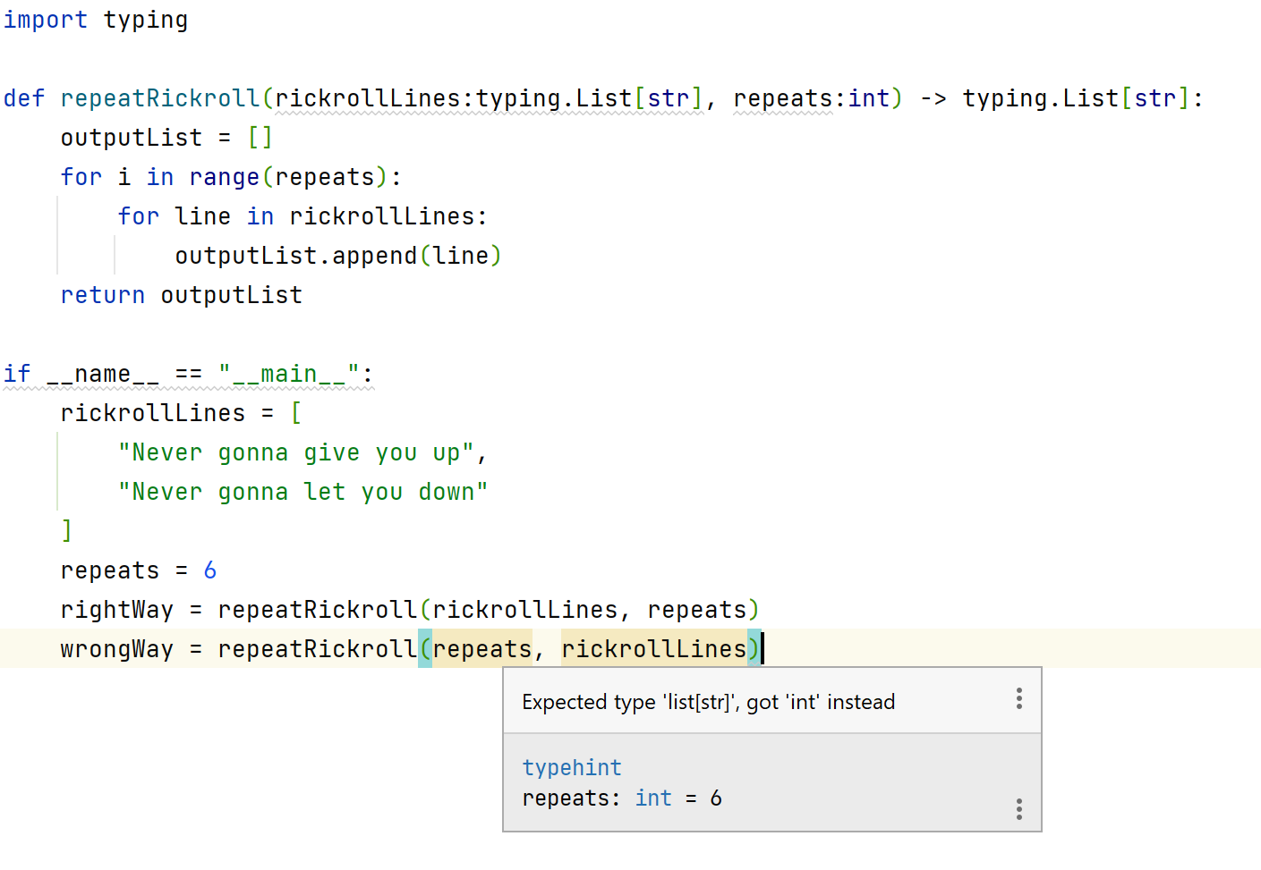
Type hinting
Makes clear what types should be getting passed
Makes clear what types should be getting returned
Not enforced by the Python interpreter

Slide 20
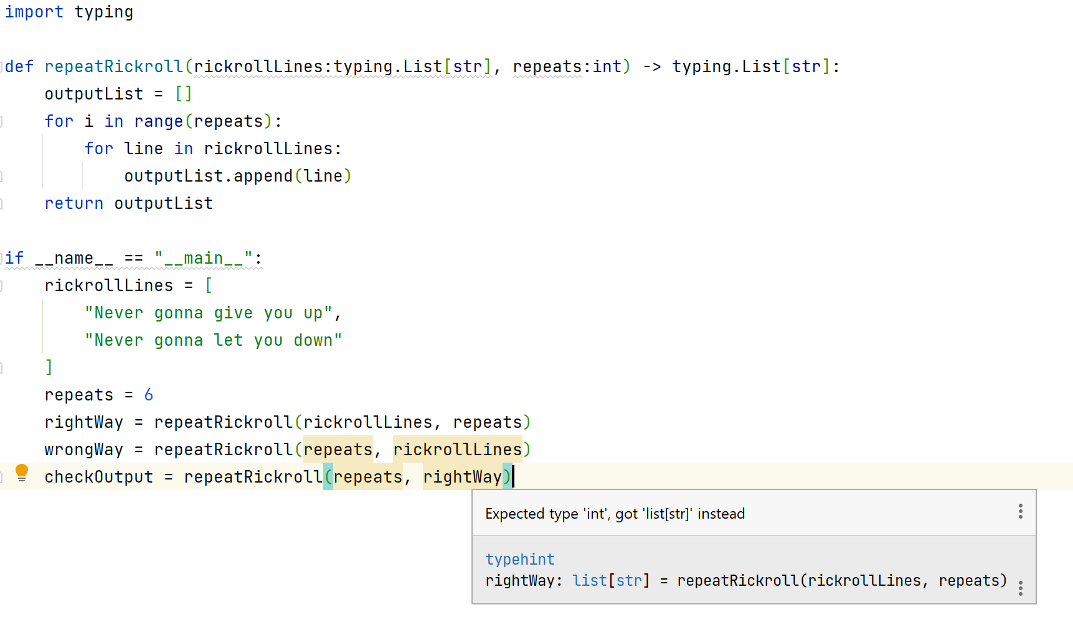
Type hinting
Note that here it knows that the output stored in rightWay
will be the wrong type of input because the output was type hinted

Slide 21
Today’s coding
Rock, Paper, Scissors

Slide 22
Making the RPS program
What are the possible outcomes of the game?
What triggers each one and how generalized/flexible can you get the data structure and algorithm to support it?
How do we get the player’s throw?
How do we get the computer’s throw?
What do we need in our environment?

Slide 23
THANK YOU
Tomorrow we will add more features and turn our RPS app into a functional web app.

